Slide 1

Planning for LEED®
Leadership in Energy and Environmental Design
LEED and related logo is a trademark owned by the U.S. Green Building Council and is used by permission
Civil Engineering and Architecture
© 2010 Project Lead The Way, Inc.

Slide 2

Planning for LEED
LEED Building Types
What is the Function of LEED?
Classification for
LEED Credits
ID Innovation & Design
LL Location and Linkages
SS Sustainable Site
WE Water Efficiency
EA Energy and Atmosphere
MR Materials and Resources
IEQ Indoor Environmental Quality
AE Awareness and Education
Four Levels of LEED Certification
Home Size Adjustment
Cost of LEED
Certification for Architects and Designers
Notes:
Civil Engineering and Architecture
Unit2– Lesson 2.3 – Residential Design
Project Lead The Way, Inc.
Copyright 2010
Planning for LEED

Slide 3
LEED Defined
Leadership in Energy and Environmental Design
An independent program developed by the U.S. Green Building Council that provides benchmarks for the design, construction, and operation of high performance green buildings
Notes:
LEED verifies the structure and the green features that were put into a building’s design.
Civil Engineering and Architecture
Unit2– Lesson 2.3 – Residential Design
Project Lead The Way, Inc.
Copyright 2010
Planning for LEED

Slide 4
LEED Building Types
New construction
Existing buildings
Commercial interiors
Core and shell
Schools
Homes
Neighborhood development
Retail
Health care
Notes:
[After presenting all categories of LEED, click]. We will concentrate on LEED for Homes in this presentation. Take careful notes so that you can incorporate LEED into your Affordable Home design.
Civil Engineering and Architecture
Unit2– Lesson 2.3 – Residential Design
Project Lead The Way, Inc.
Copyright 2010
Planning for LEED

Slide 5
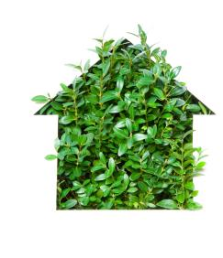
What is the Function of LEED?
Developed by the USGBC (United States Green Building Council) in 1999
Goal: Provide guidelines for professionals to improve the quality of our buildings and their impact on the environment
Notes:
Buildings represent 39% of energy use in the United States. Buildings are heavy consumers of natural resources and account for a significant portion of the greenhouse gas emissions that affect climate change.
Civil Engineering and Architecture
Unit2– Lesson 2.3 – Residential Design
Project Lead The Way, Inc.
Copyright 2010
Planning for LEED

Slide 6
Why LEED Certify?
Reduce the building’s carbon footprint
Receive recognition for your commitment to environmental issues in your community, your organization, and industry
Receive third party validation of achievement
Qualify for federal, state, and local government financial initiatives
Receive positive marketing exposure
Notes:
LEED certification provides a marketable credential to an employer, prospective employer, or client.
Civil Engineering and Architecture
Unit2– Lesson 2.3 – Residential Design
Project Lead The Way, Inc.
Copyright 2010
Planning for LEED

Slide 7
Classification for LEED for Homes Credits
ID Innovation in Design
LL Location and Linkages
SS Sustainable Site
WE Water Efficiency
EA Energy and Atmosphere
MR Materials and Resources
IEQ Indoor Environmental Quality
AE Awareness and Education
Notes:
LEED credit can be obtained for new construction and existing buildings. Design teams of architects, civil engineers, MEP (mechanical, electrical, and plumbing) and landscape architects may coordinate the entire project together. The green building design movement will include more attempts at bringing outdated or under-performing buildings up to “Greener” levels.
Civil Engineering and Architecture
Unit2– Lesson 2.3 – Residential Design
Project Lead The Way, Inc.
Copyright 2010
Planning for LEED

Slide 8
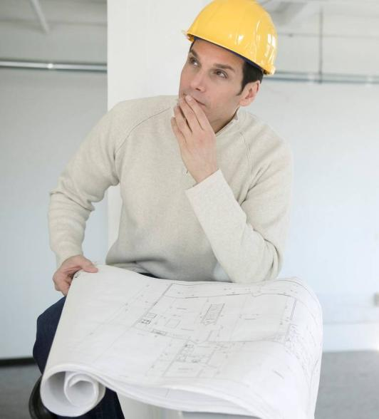
ID Innovation and Design
Architects who use special design methods, approaches not identified in the outlined credits, or exemplary performance levels may be eligible to receive special recognition
Notes:
ID credits encourage an integrated project team with at least one member of the project team being certified in LEED for Homes. Credit is also given for a full-day design charrette and for designs maximizing solar orientation. Durability of the building and systems is also encouraged.
Civil Engineering and Architecture
Unit2– Lesson 2.3 – Residential Design
Project Lead The Way, Inc.
Copyright 2010
Planning for LEED

Slide 9
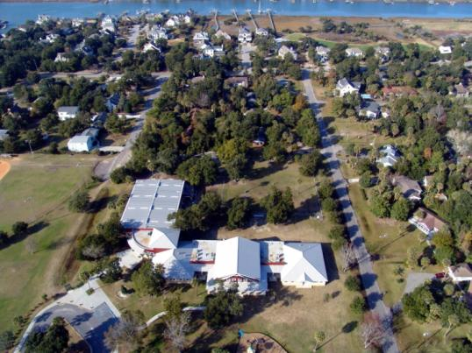
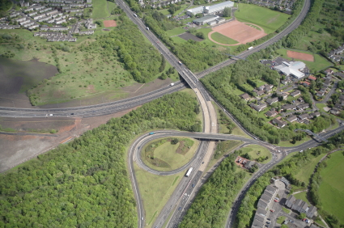
LL Location and Linkages
Encourages the placement of homes in socially and environmentally responsible ways in relation to the larger community
Courtesy Isle of Palms, SC Recreation Department
©iStockphoto.com
Notes:
Discourages the use of sites within fragile ecosystems and encourages development of sites that border previously developed land or building on a previously developed site. Credits are also available for sites that provide access to open space and allow walking, biking, and public transit to nearby facilities.
Civil Engineering and Architecture
Unit2– Lesson 2.3 – Residential Design
Project Lead The Way, Inc.
Copyright 2010
Planning for LEED

Slide 10
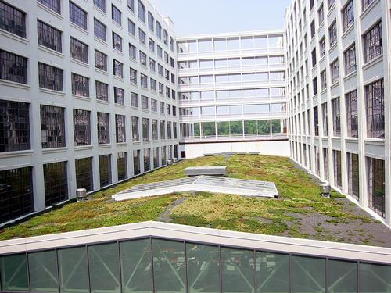
SS Sustainable Site
The use of the entire property to minimize the project’s impact on the site is encouraged
Notes:
Site developers are encouraged to minimize the disturbed area of the site and build at moderate or high density (i.e., put more houses in a given area). SS credits are also given for low impact landscaping and for minimizing the area of non-permeable surfaces.
Civil Engineering and Architecture
Unit2– Lesson 2.3 – Residential Design
Project Lead The Way, Inc.
Copyright 2010
Planning for LEED

Slide 11
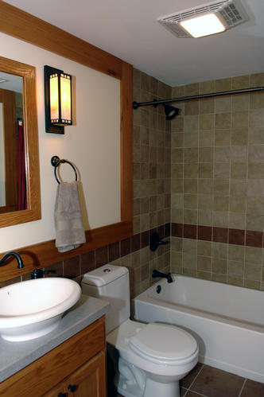
WE Water Efficiency
Careful attention is given to promoting water conservation both indoor and outdoor
Notes:
Using captured rainwater or reusing “greywater” from home sinks and showers can provide a five point LEED credit. Using water-efficient irrigation and installing high efficiency shower heads, faucets, and urinals can greatly reduce water consumption in a building.
Civil Engineering and Architecture
Unit2– Lesson 2.3 – Residential Design
Project Lead The Way, Inc.
Copyright 2010
Planning for LEED

Slide 12

EA Energy and Atmosphere
Promotion of on-site renewable energy resources and maximization of energy performance help protect the environment and human health
Notes:
Reducing the need for natural energy resources helps reduce pressure on the environment. LEED credit is given to homes that exceed the ENERGY STAR performance requirements. Careful attention to
insulation, air infiltration, window selection, heating and cooling systems, lighting , appliances, and water heating can greatly reduce energy consumption. Using renewable energy is also encouraged.
Civil Engineering and Architecture
Unit2– Lesson 2.3 – Residential Design
Project Lead The Way, Inc.
Copyright 2010
Planning for LEED

Slide 13
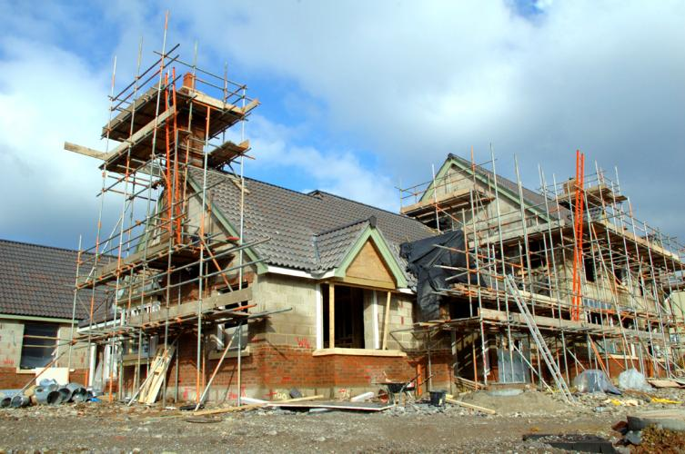
MR Materials and Resources
Efficient use of environmentally preferable materials and minimizing the amount of waste during construction reduces negative impacts on the environment
Notes:
Credit can be obtained by minimizing waste, choosing environmentally-friendly materials, and finding other uses for construction waste.
Civil Engineering and Architecture
Unit2– Lesson 2.3 – Residential Design
Project Lead The Way, Inc.
Copyright 2010
Planning for LEED

Slide 14
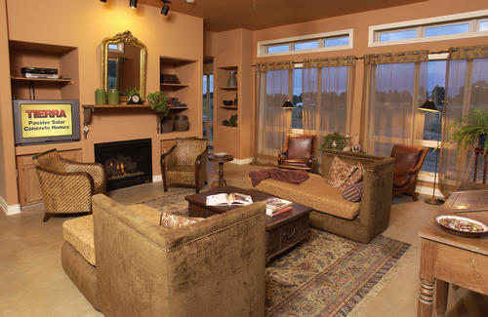
IEQ Indoor Environmental Quality
Reducing the creation of and exposure to pollutants can greatly improve the indoor air quality
Notes:
IAQ (indoor air quality) has a significant impact on the building occupants. The health of occupants should be of utmost concern for the owner of the building. With proper venting, moisture control, air filtering, and distribution of heating and cooling, the IAQ can be protected.
Civil Engineering and Architecture
Unit2– Lesson 2.3 – Residential Design
Project Lead The Way, Inc.
Copyright 2010
Planning for LEED

Slide 15
Awareness and Education
The full benefits of LEED efforts will not be realized unless the homeowner and/or building manager are informed about the operation and maintenance of green features
Notes:
Civil Engineering and Architecture
Unit2– Lesson 2.3 – Residential Design
Project Lead The Way, Inc.
Copyright 2010
Planning for LEED

Slide 16



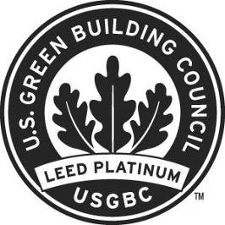
Four Levels of LEED for Homes Certification
LEED Certified
LEED Silver
LEED Gold
LEED Platinum
Notes:
Architects plan for LEED deign credits to receive certification for the building. Platinum is the highest level of LEED certification for homes.
Civil Engineering and Architecture
Unit2– Lesson 2.3 – Residential Design
Project Lead The Way, Inc.
Copyright 2010
Planning for LEED

Slide 17
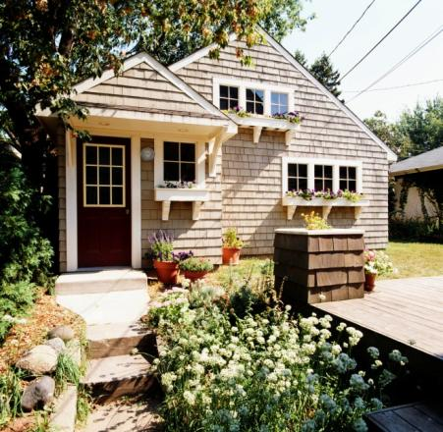
Home Size Adjustment
Larger homes consume more resources
LEED Home Size Adjustment allows for a reduction in credit point requirements for smaller homes
Notes:
Civil Engineering and Architecture
Unit2– Lesson 2.3 – Residential Design
Project Lead The Way, Inc.
Copyright 2010
Planning for LEED

Slide 18
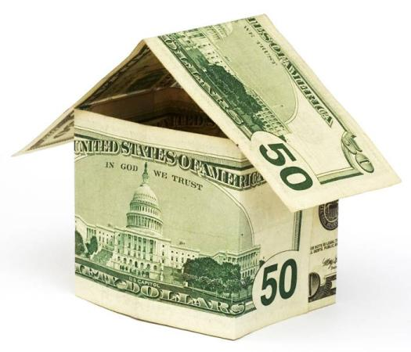
Cost of LEED
Green buildings can return cost savings depending on the design strategies for the structure. Some green designs may cost more up front, but they can save money due to lower operating costs during the life of the building.
Notes:
Mechanical systems and green building materials may have up-front costs due to special manufacturing methods during production.
Civil Engineering and Architecture
Unit2– Lesson 2.3 – Residential Design
Project Lead The Way, Inc.
Copyright 2010
Planning for LEED

Slide 19
Certification for Architects and Designers
Certification can be obtained by design professionals through classes, seminars, and testing. Once training is complete, designers can become a LEED AP (Accredited Professional).
Notes:
LEED Accredited Professionals use their training and experience to design the most sustainable buildings possible.
Civil Engineering and Architecture
Unit2– Lesson 2.3 – Residential Design
Project Lead The Way, Inc.
Copyright 2010
Planning for LEED

Slide 20
Planning for LEED
LEED Building Types
What is the Function of LEED?
Classification for
LEED Credits
ID Innovation & Design
LL Location and Linkages
SS Sustainable Site
WE Water Efficiency
EA Energy and Atmosphere
MR Materials and Resources
IEQ Indoor Environmental Quality
AE Awareness and Education
Four Levels of LEED Certification
Home Size Adjustment
Cost of LEED
Certification for Architects and Designers
Notes:
Civil Engineering and Architecture
Unit2– Lesson 2.3 – Residential Design
Project Lead The Way, Inc.
Copyright 2010
Planning for LEED

Slide 21
Image Resources
Microsoft, Inc. (2009). Clip art. Retrieved April 7, 2009, from http://office.microsoft.com/en-us/clipart/default.aspx
Istockphoto. Retrieved March 1, 2010, from www.istockphoto.com.
Isle of Palms Recreation Department. Isle of Palms, SC 29451
Notes:
Civil Engineering and Architecture
Unit2– Lesson 2.3 – Residential Design
Project Lead The Way, Inc.
Copyright 2010
Planning for LEED

